Slide 1
Number Strategies
Topic: Addition
EQ: What strategies can we use to add numbers and money?
Mrs Stretch
Year 10 OLNA

Slide 2
Last Week Recap
Round to 4 decimal places: 36.49184628 ________________
Round to the nearest 5 cents: $49.33 ___________________
58.382 x 100 = __________________
0.038 x 10 = _______________________
481.48 ÷ 1000 = _______________

Slide 3
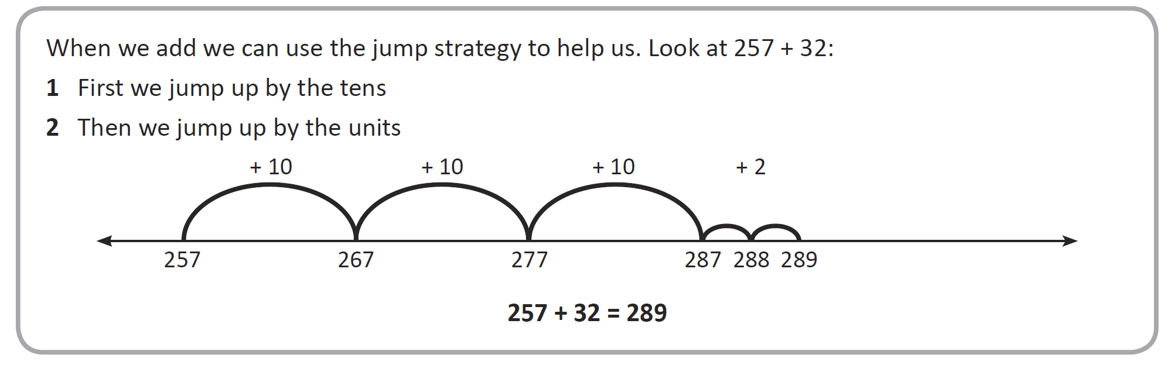
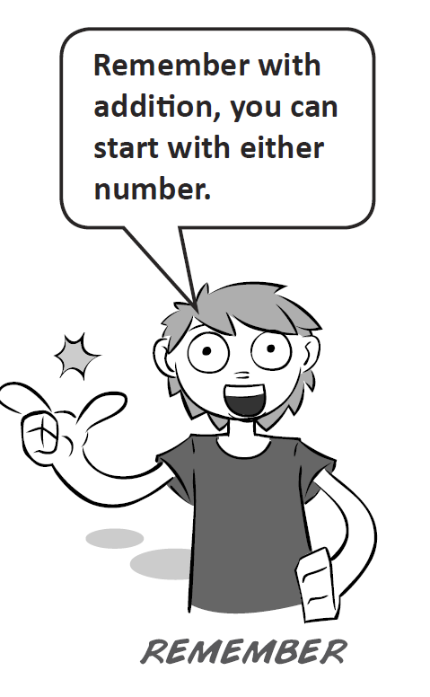
24
7
30
Addition
Date
EQ – What strategies can we use to add numbers and money?
Mental Strategy 1
Jump Method

Slide 4
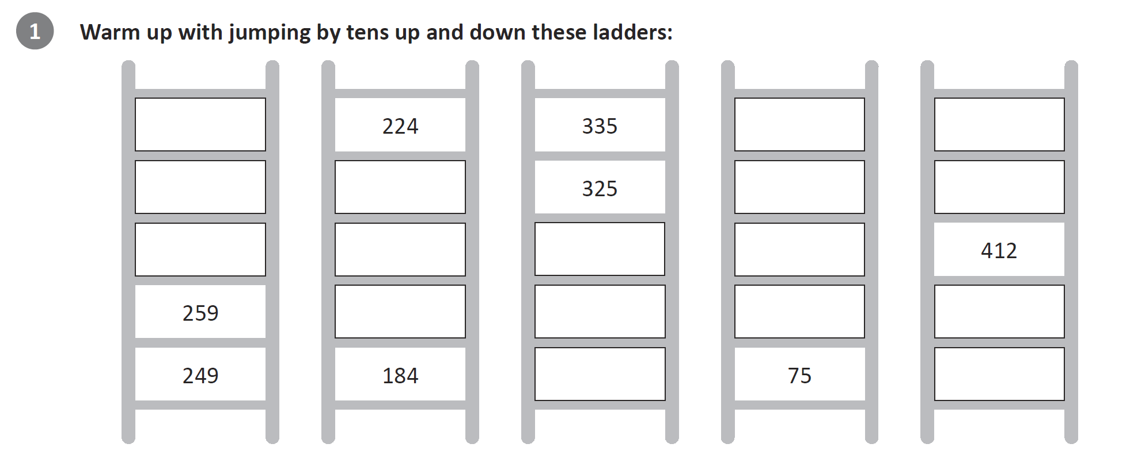
Practice

Slide 5
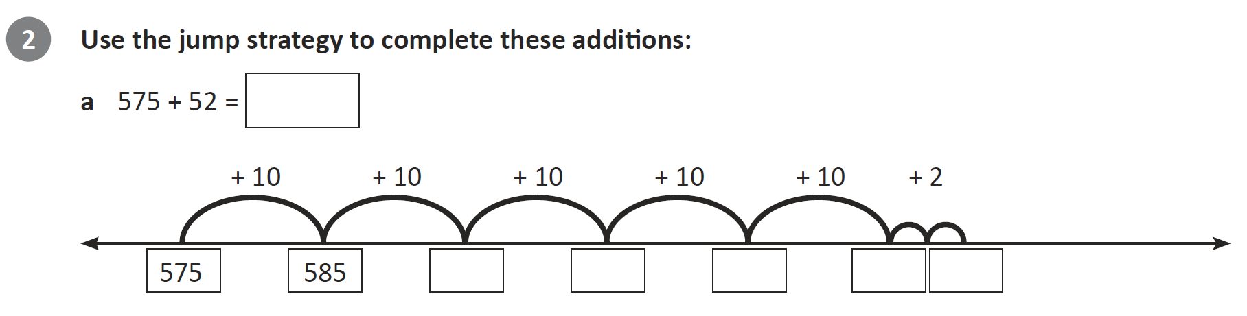
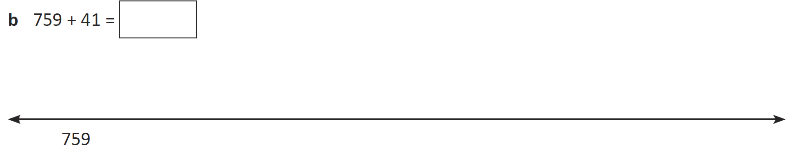

Slide 6
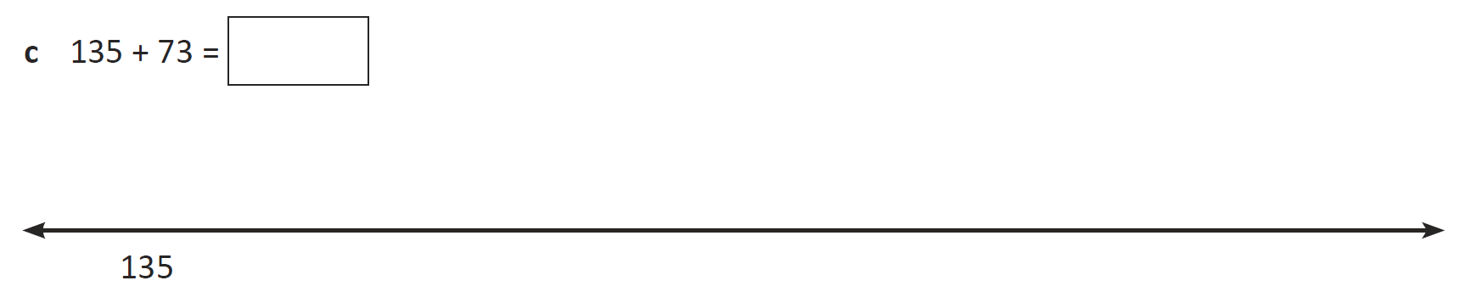

Slide 7
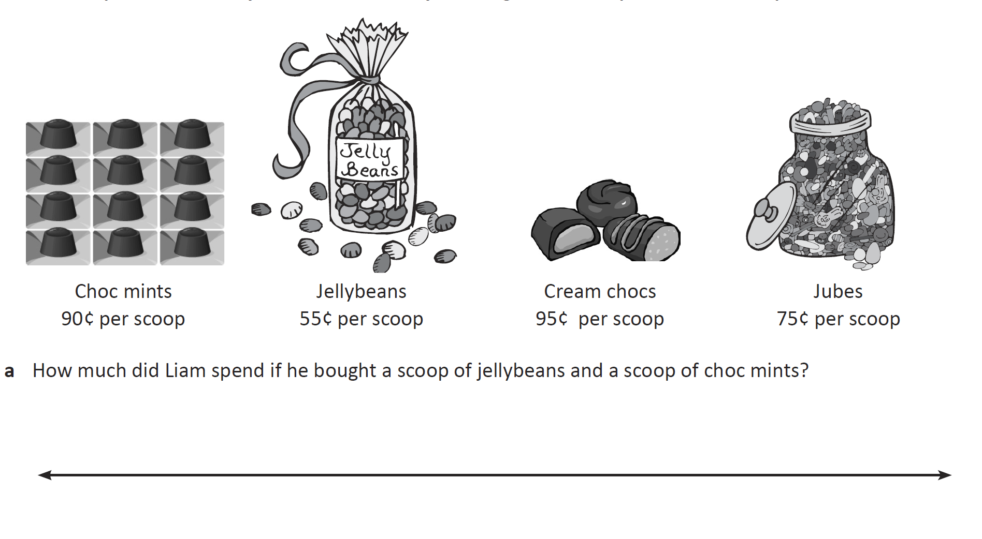

Slide 10


Slide 11
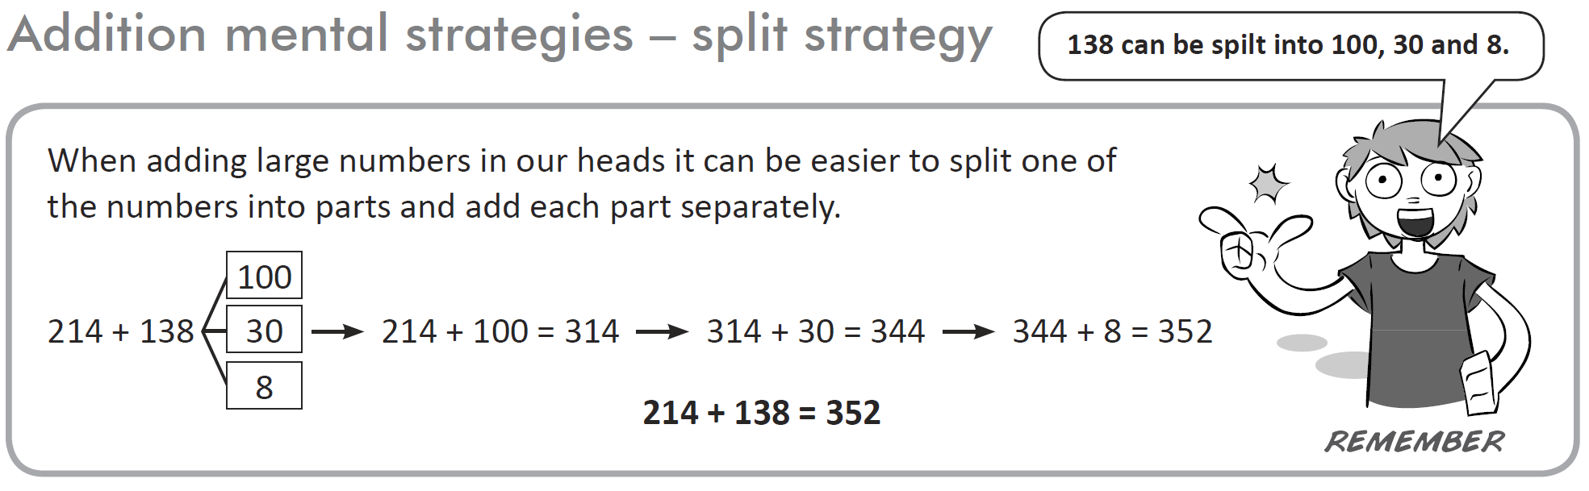
24
7
30
Addition
Date
EQ – What strategies can we use to add numbers and money?
Mental Strategy 2
Split Method

Slide 12
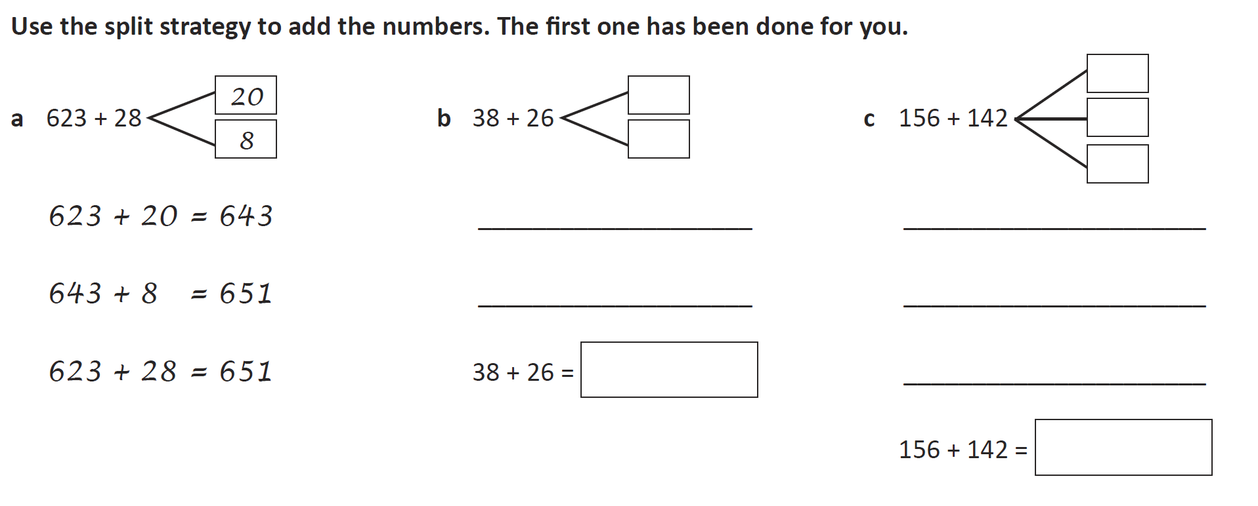
Practice

Slide 13
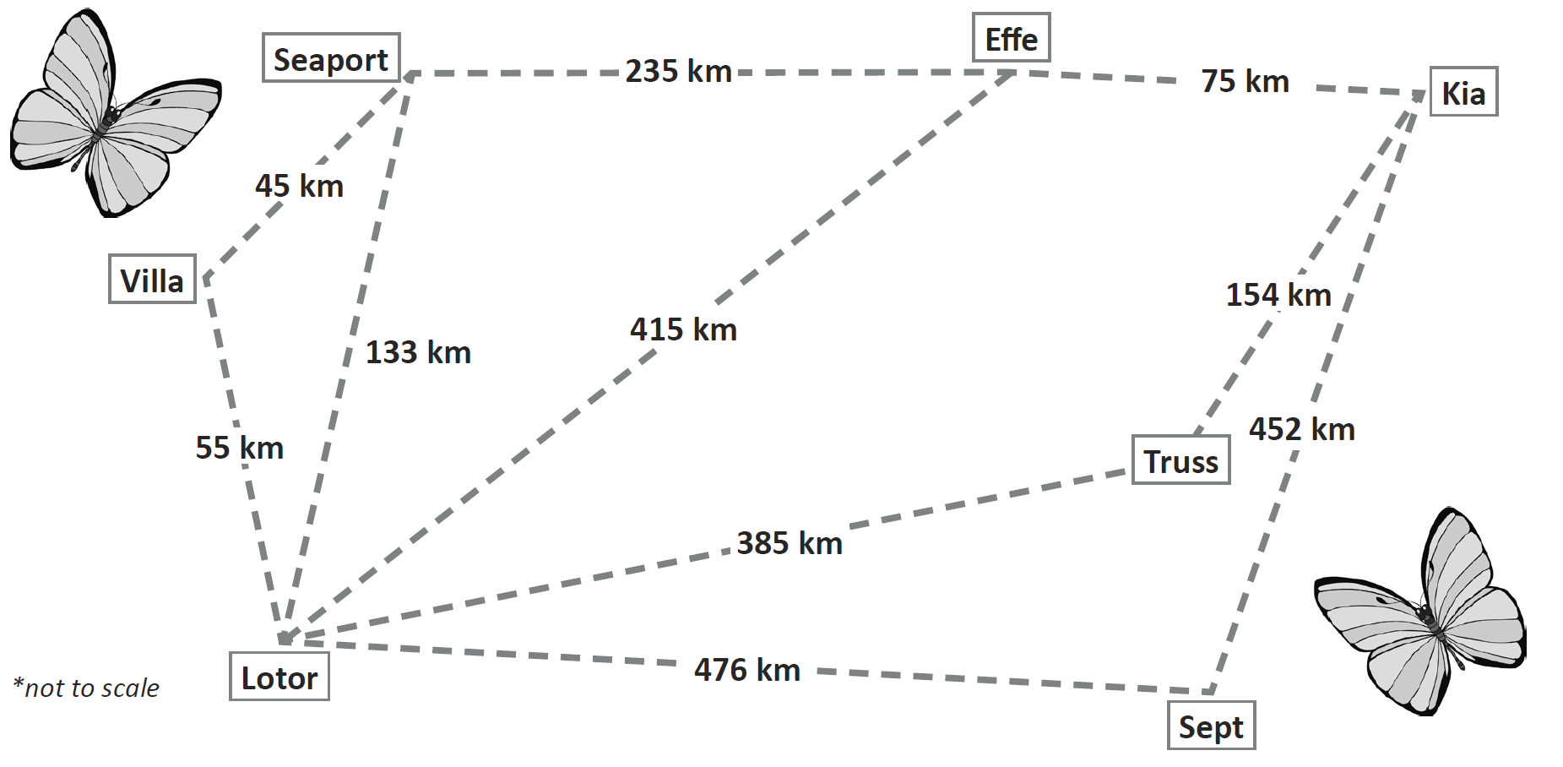
Notes:
Write on board:
Flies from Lotor to Villa then to Seaport
Flies from Sept to Lotor then to Villa
Flies from Seaport to Effe then to Kia
Use split method to work out distances

Slide 14
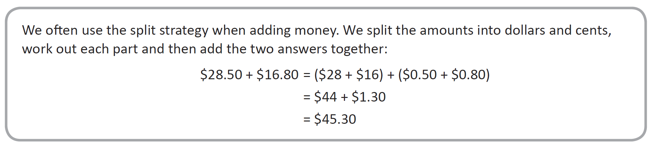
24
7
30
Addition
Date
EQ – What strategies can we use to add numbers and money?
Mental Strategy 2
Split Method

Slide 15
